Slide 1
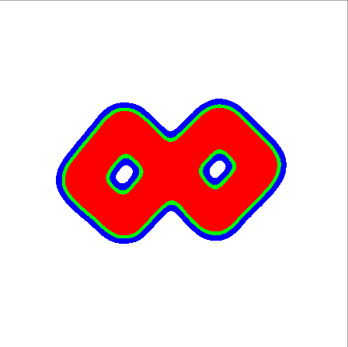
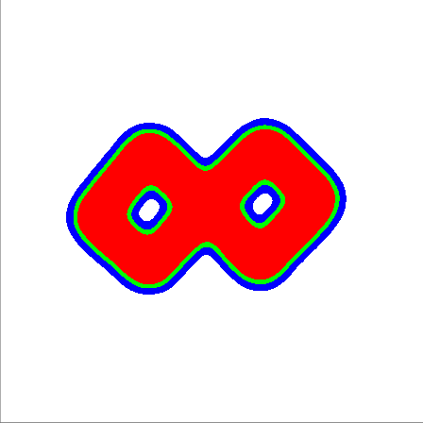
Deformation Gradient Control In the Material Point Method
Michael Xu
MOTOGRAPH 2019

Slide 2
Problem Statement
Produce animations of shapeshifting amorphous objects through physical simulation
More specifically:
Given a physical object and a target shape, how can we control the deformation of the object to match the target shape in a physical environment using only internal forces?

Slide 3
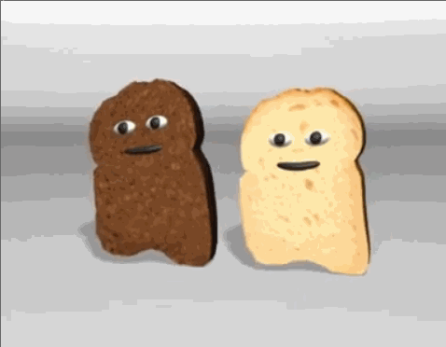
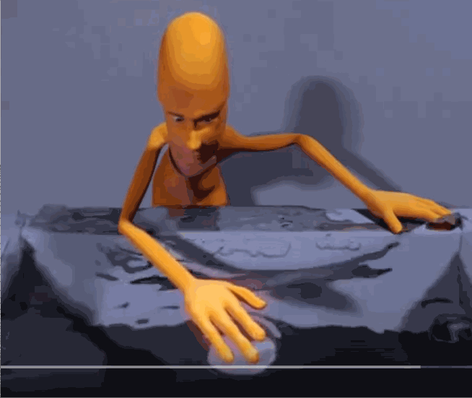
Related WORK (Control)
Fluid Control Using the Adjoint Method (2004)
Deformable Objects Alive! (2012)
Blender Magic Fluids (2005, YouTube)

Slide 4

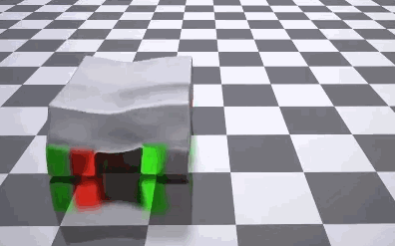
Related Work (MPM)
A Material Point Method For Snow Simulation (2013)
ChainQueen: A Real-Time Differential Physical Simulator for Soft Robotics (2018)
Introduction of MPM to graphics
Controlling a soft robotic with actuators (stress-based control)

Slide 5
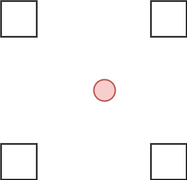
MPM BASICs
Particles carry physical and material properties.
Particles need some way of affecting each others' dynamics (like “intermolecular forces”).
Grids are computational scratchpads that approximate the “intermolecular forces”.

Slide 6
Particle Properties
- Mass
- Velocity
- Position
- Deformation Gradient (represented as F)
- Material Parameters
- Affine Velocity Transfer Matrix (not part of basic MPM)

Slide 7
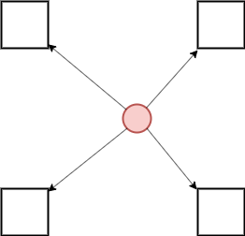
Particle to Grid (P2G)
Particles project mass, momentum, and internal forces onto the grid.
This is done using basis/shape functions defined on the grid nodes.

Slide 8
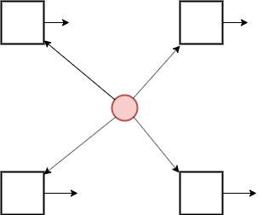
Grid Update (G)
Grid calculate current velocity from momentum / mass, then updates velocity from external and internal forces

Slide 9
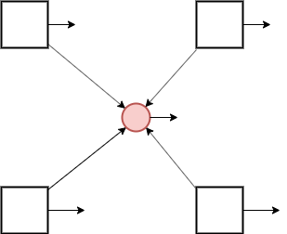
Grid To Particle (G2P)
Grid projects velocity onto particles, and updates particle deformation gradient

Slide 10
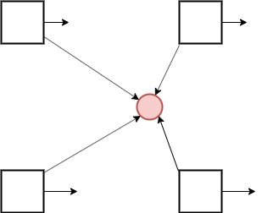
Particle Update (P)
Particle moves in direction of new velocity

Slide 11
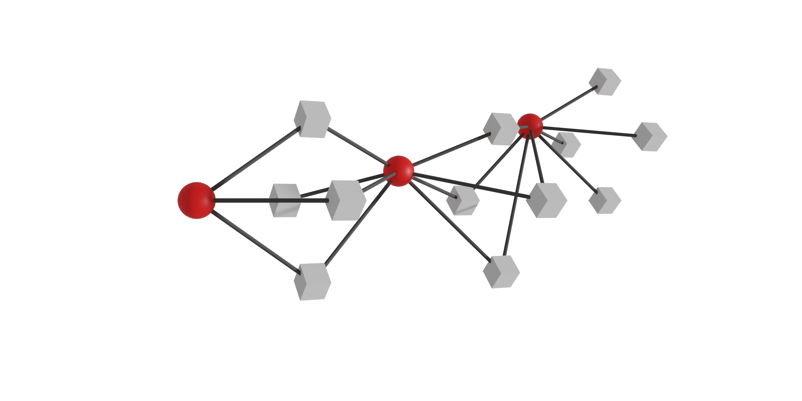
Space-Time view of MPM computation graph
Rendered by Derek Liu

Slide 12
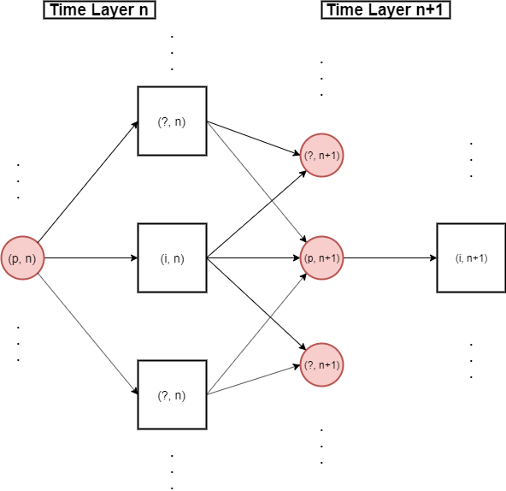
Physical Simulations are Computation Graphs

Slide 13
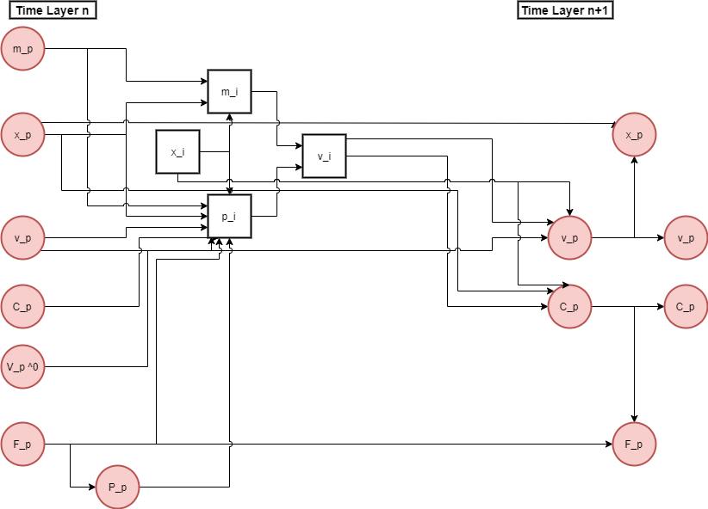
The computation graph between one particle and on grid node

Slide 14
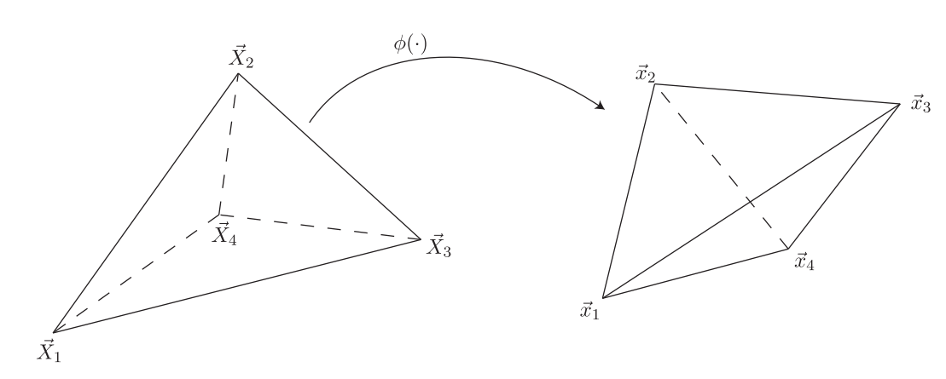
Deformation Gradients IN FEM
Are calculated from a reference tetrahedral mesh
From Siggraph 2012 FEM course notes

Slide 15
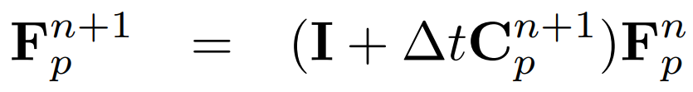
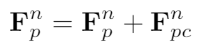
Deformation Gradients in MPM
Are incrementally calculated by this formula (MLS-MPM specifically)
What if we added an extra control deformation gradient?

Slide 16
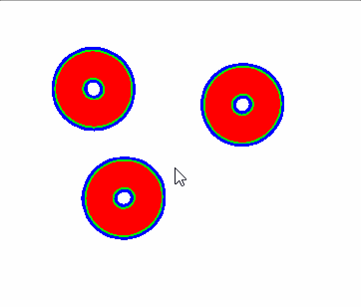
Playing with Deformation Gradients

Slide 17
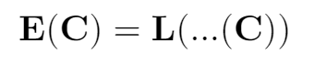
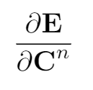
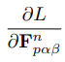
Optimizing deformation gradients
We want to optimize the deformation gradients so that the final shape of the MPM body is as close as possible to some shape we define.
To do this, we will need to define some kind of loss function which tells us how close our final MPM shape is to the target shape.
Then we will need to perform gradient descent on these gradients:

Slide 18
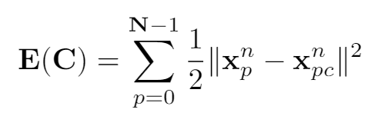
Least Squares Position Loss function
C: tensor of control variables (deformation gradients in our case)

Slide 19
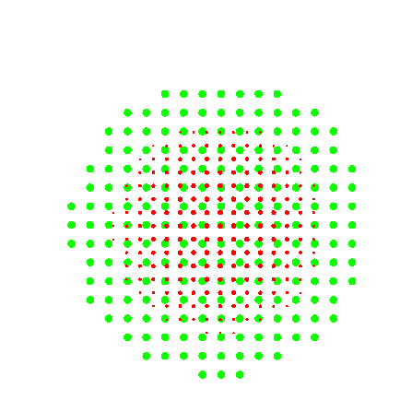

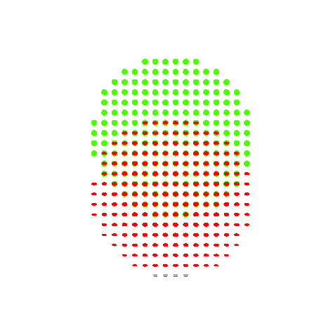

Slide 20
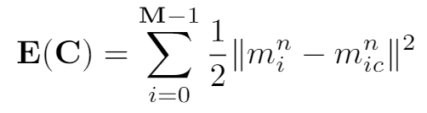
Least Squares GRID-mASS LOSS FUNCTION

Slide 21
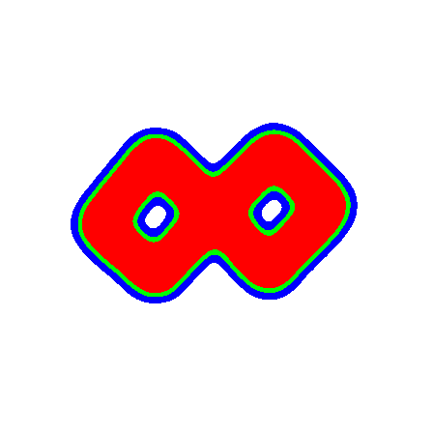
Topology Change

Slide 22
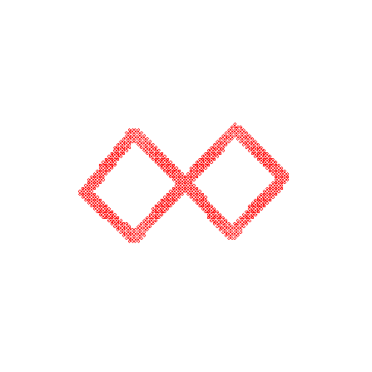
A note on MPM rendering
Using the same basis/shape functions, we can render the MPM body by projecting mass from the grid nodes to every pixel.

Slide 23
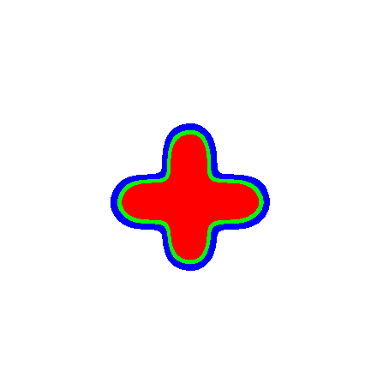
MORE FUN

Slide 24
Next Steps
-Using a finer loss function grid (while still using a coarser simulation grid)
-Material parameter control?
-Mass control? (Give the mpm bodies something to push on, may need to change the loss function for this)
-3D

Slide 25

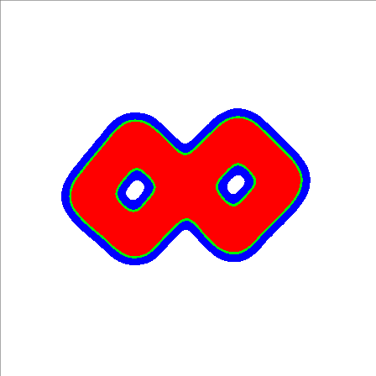



Thank you! Any Questions?

